Slide 1
DOCKER
T

Slide 2
CONTENT
What is a docker?
What is docker images?
Why do you need dockers?
Docker network
What are containers?
Docker architecture
Docker basic commands

Slide 3
Docker
Package application or open platform.
Docker is a tool designed to make it easier to create, deploy, and run applications by using containers

Slide 4
DOCKER IMAGE
Read only templates used to create containers.
Built by docker users.
Shored in docker hub or your local registry.

Slide 5
WHY DO YOU NEED DOCKERS
To make it easier to create, deploy, and run applications by using containers.
It as one package.

Slide 6
DOCKER NETWORK
There are five network drivers in docker:
BRIDGE(default)
HOST
NONE
OVERLAY
MACVLAN

Slide 7
BRIDGE
Bridge is the default network driver of docker.
Bridge networks are usually used when your applications run in standalone containers that need to communicate.

Slide 8
HOST
For standalone containers.
remove network isolation between the container and the Docker host.

Slide 9
NONE
For this container, disable all networking.
Usually used with a custom network driver.

Slide 10
MACVLAN
Macvlan are used to assign a mac address to containers.
It improves the performance of the network connectivity.

Slide 11
OVERLAY
Application containers speaks with other container, overllay are used.

Slide 12
CONTAINERS
Light weight virtual machine.
It contains everything needed to run the application.
Buid from one or more images.

Slide 13
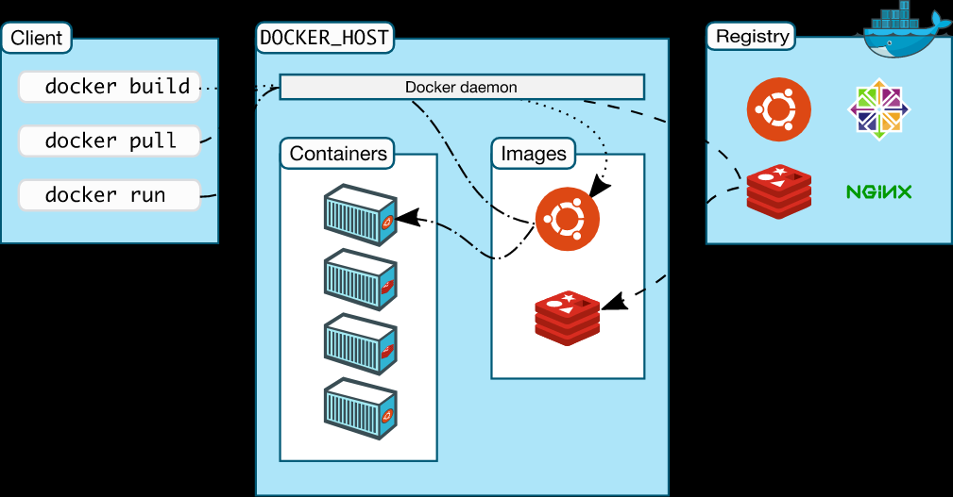
ARCHITECTURE OF DOCKER

Slide 14
DOCKER ARCHITECTURE
To build a Docker Image, we can use the CLI (client) to issue a build command to the Docker Daemon (running on Docker_Host). The Daemon will then build an image based on our inputs and save it in the Registry, which can be either Docker hub or a local repository

Slide 15
DOCKER ARCHITECTURE
If we do not want to create an image, then we can just pull an image from the Docker hub, which would have been built by a different user.

Slide 16
DOCKER ARCHITECTURE
Finally, if we have to create a running instance of my Docker image, we can issue a run command from the CLI, which will create a Container.

Slide 17
DOCKER BASIC COMMANDS
docker --version
docker pull <image name>
docker run -it -d <image name>
docker ps
docker ps –a
docker exec -it <container id> bash
docker stop <container id>
docker kill <container id>

Slide 18
DOCKER BASIC COMMANDS
docker commit <conatainer id> <username/imagename>
docker images
docker rm <container id>
docker rmi <image-id>

Slide 19
THANKYOU HAVE A NICE DAY !!
BY,
SHAFIUR RAHMAN A

